Slide 1

Deep Learning Mini Project
Handwritten Character Recognition
Made By:
Angel Negi(1032170667)
Aniket Kumar(1032171203)
Adesh Pawar(1032170104)
Aditya Khandelwal(1032170752)
Guided By:
Prof Anita Gunjal

Slide 2





Problem Statement
Though the goal is to create a model which can recognize the digits, it can be extended to letters and an individual's handwriting. The major goal of the proposed system is understanding Convolutional Neural Network and applying it to the handwritten recognition system.

Slide 3
Dataset Used
1. MNIST:
a. The MNIST dataset is an acronym that stands for the Modified National Institute of Standards and Technology dataset.
b. Size of Dataset : 122.2 MB
c. It is a dataset of 60,000 small square 28×28 pixel grayscale images of handwritten single digits between 0 and 9.
d. The set of images in the MNIST database was created in 1998 as a combination of two of NIST's databases
2. EMNIST:
a. The EMNIST dataset is a set of handwritten character digits derived from the NIST Special Database 19 and converted to a 28x28 pixel image format and dataset structure that directly matches the MNIST dataset . Further information on the dataset contents and conversion process can be found in the paper available at https://arxiv.org/abs/1702.05373v1
b. There are six different splits provided in this dataset. A short summary of the dataset is provided below:
EMNIST ByClass: 814,255 characters. 62 unbalanced classes.
EMNIST ByMerge: 814,255 characters. 47 unbalanced classes.
EMNIST Balanced: 131,600 characters. 47 balanced classes.
EMNIST Letters: 145,600 characters. 26 balanced classes.
EMNIST Digits: 280,000 characters. 10 balanced classes.
EMNIST MNIST: 70,000 characters. 10 balanced classes.

Slide 4
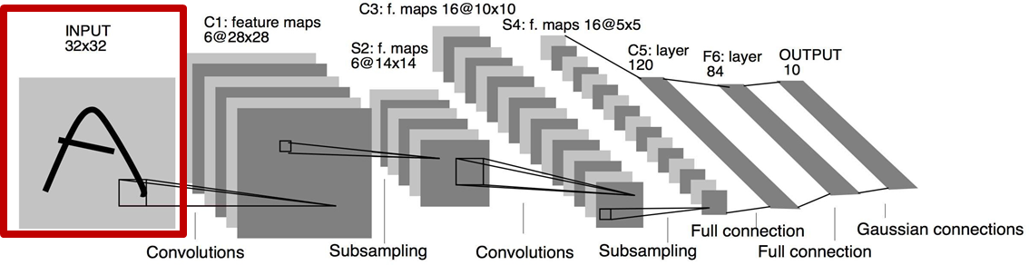

Methodology

Slide 5
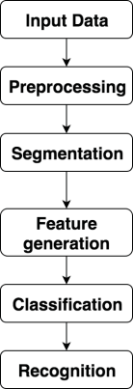
Steps Involved in Handwritten recognition system

Slide 6
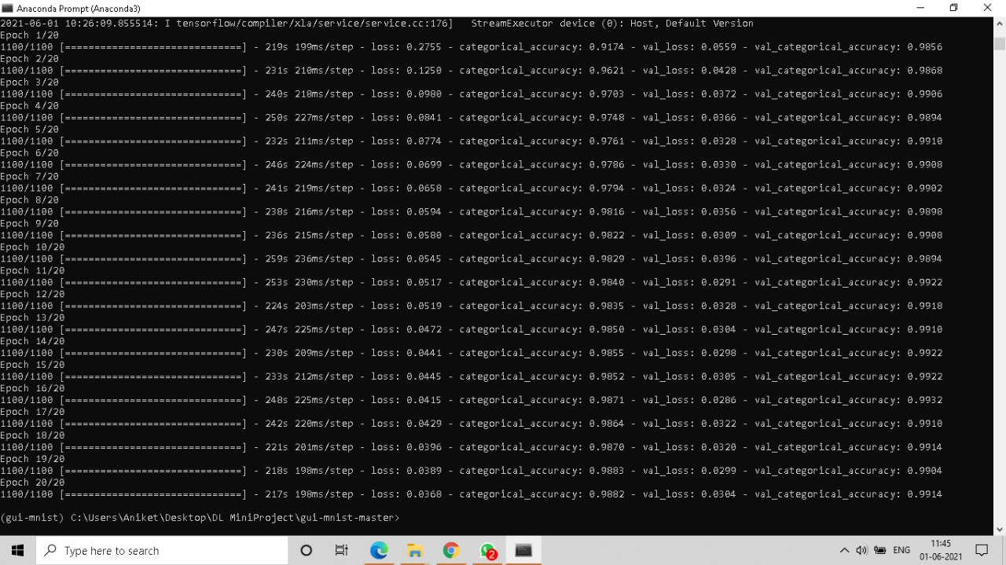
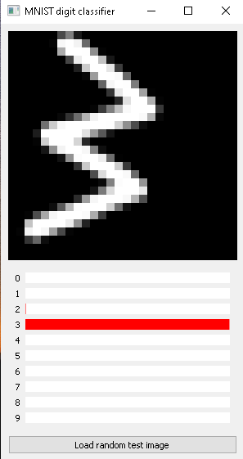
Output

Slide 7
Applications
1) Reading postal addresses
2) Reading Bank cheque and amounts.
3) Reading the forms filled by individuals.
4) Digitizing old books in editable form.
5) Extended research :-
text to speech conversion (e-book reading) which can be helpful to visually impaired people.

Slide 8
Future Scope
This trend will probably happen quite slowly though, and handwriting will probably not completely lose its significance, at least not during the next few generations.
But looking into the positive aspects a lot of tasks can be automated by extending the Handwritten Recognition from text to speech conversion.
The future of handwritten recognition system is difficult to predict, but one scenario, not a very optimistic one, suggests that handwriting skills are starting to degenerate with the increased keyboard use.

Slide 9

Conclusion
The main aim of this project is to find a representation of handwritten digits that allow their effective recognition. In this project, we used different machine learning algorithm for recognition of handwritten numerals. In any recognition process, the important problem is to address the feature extraction and correct classification approaches. The proposed algorithm tries to address both the factors and well in terms of accuracy and time complexity. The overall highest accuracy 98.82% is achieved in the recognition process by Multilayer Perceptron.

Slide 10

THANK YOU

